Slide 1
HOW
WOW

Slide 2
HOW!

Slide 3



Slide 4
#reporthowwow
@parapowwow

Slide 5
Report writing howwow bonanza
The tech the words the rules

Slide 6
The words
emily bate
quietroom
the tech
David pike
brochet
the rules
Mark goold
the fca

Slide 7
The words
emily bate
quietroom
the tech
David pike
brochet
the rules
Mark goold
the fca
😷

Slide 8
The words
Joe craig
quietroom
the tech
David pike
brochet
the rules
Mark goold
the fca

Slide 9
paraplanner panel
report writing gripes & samples

Slide 10
joe
craig

Slide 11
How(wow) to get the words right in your reports
Emily Bate – Writer 😷
Joe Craig – Writer

Slide 12
Money
Energy
Health
Society
Notes:
We exist to make money, health, energy and society more meaningful…
The issues that most affect our future are often the ones that excite us least. Money, health, energy and society are important, but they’re also invisible and intangible. They’re hard to understand and even harder to love. But we can only make good choices if we understand those choices and what they mean for us.

Slide 13
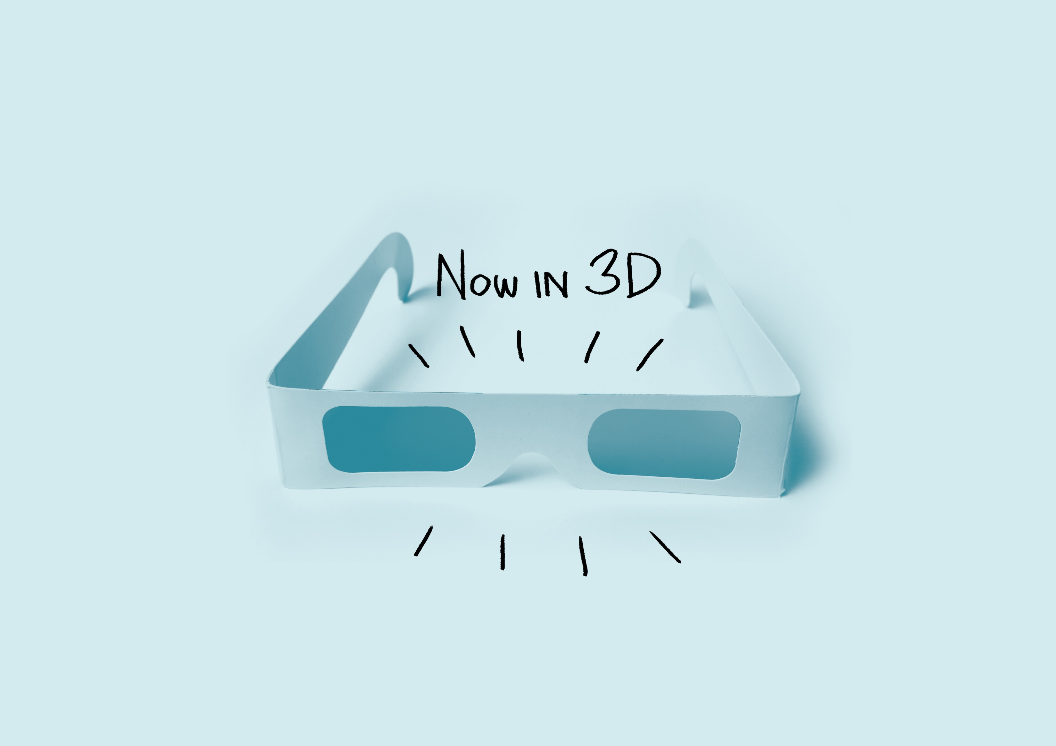
Clear Vivid Real
Notes:
We do that by helping organisations write and talk in a way that’s clear, vivid and real…
We work with lots of experts. The problem is that it’s hard for experts to talk to people who know and care less than them. They say too little, because they assume the other person knows more than they do. They say too much or too little or use jargon. Their communication gets complex, dull and abstract – meaning it leaves people cold.
So we specialise in words (and how they bring people together)
We think forensically about how language shapes the way people react to you
We talk about why words matter (and how they affect our world)

Slide 14
The way we talk to people shapes the way they react to us
Notes:
The way we talk to people shapes the way they react to us. And that drives the result you get.
We know that the words people use can make us feel differently. We know this is true in our personal lives, as well as in business. For instance, imagine someone walks into your living room…

Slide 15
Friendly
Rude
That chair’s got so much character – is it vintage?
That chair looks a bit worn – is it second-hand?
Notes:
If they said to you: “That chair’s got so much character – is it vintage?” you’d probably feel quite good. You’d quite like this friendly person.
If they said instead: “That chair looks a bit worn – is it second-hand?”, you wouldn’t feel quite so good. You’d probably be a bit miffed.
The same information, presented differently, gets a totally different reaction. So words can change how you feel about a person or a thing. And as a result, they can change your behaviour. You might offer the friendly person a second cup of tea. You might not answer the door to the rude person next time.

Slide 16
The way we talk to people tells them what we’re like
Notes:
The way we talk to people tells them what we’re like. Take this next slide as an example.

Slide 17
Put the mushrooms in a bowl and add the chopped herbs, a pinch of salt and the lemon juice. Using your hands, get stuck in and toss everything together – this is going to be incredible!
Take your risotto and add a little more seasoning if you like. Serve a good dollop of risotto topped with some grilled mushrooms, a sprinkling of freshly grated Parmesan and a drizzle of extra virgin olive oil.
Notes:
How to make a mushroom risotto

Slide 18
First of all, you need to soak the dried porcini mushrooms and to do this, you place them in a jug or a bowl and pour 570 ml of boiling water over them. Meanwhile, chop the fresh mushrooms into 1 cm chunks – not too small, as they shrink down quite a bit in the cooking.
When the mushrooms have soaked for half and hour, place a sieve over a bowl, line the sieve with a sheet of kitchen paper and strain the mushrooms, reserving the liquid.
Notes:
How to make a mushroom risotto
They’re both making the same thing, but you’d probably prefer to follow one recipe over the other? Which one?

Slide 19
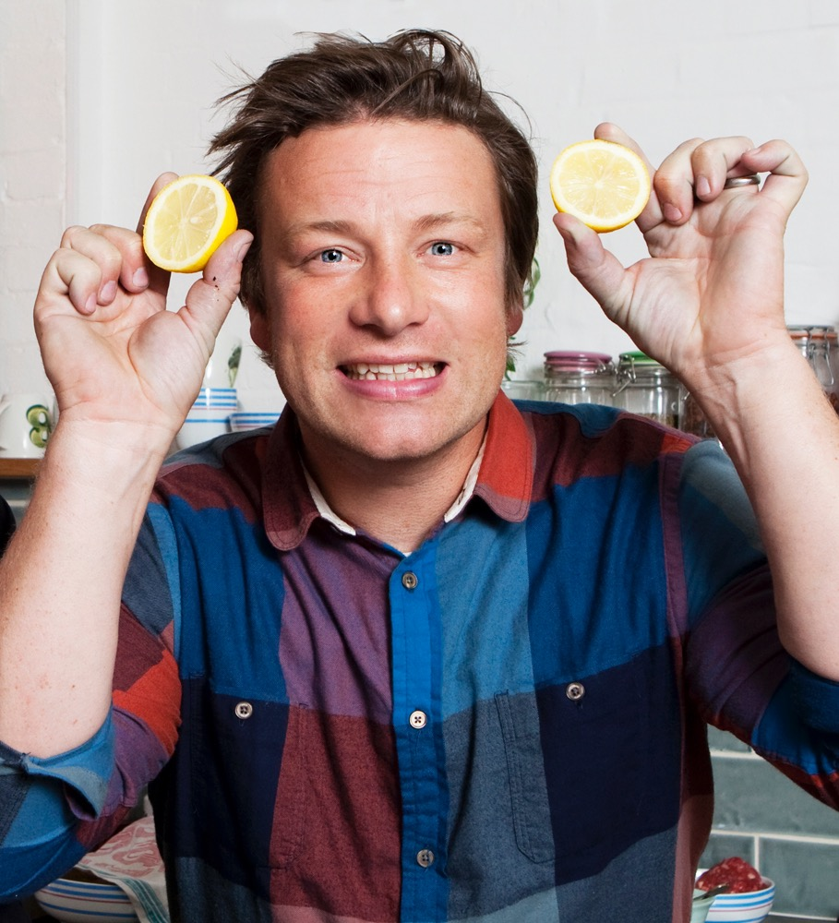
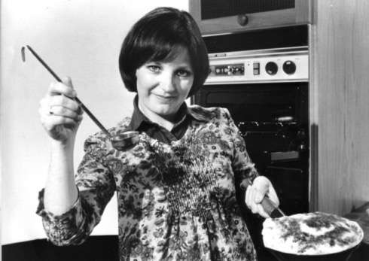

Notes:
Jamie Oliver – all about throwing things in, it’s going to be incredible, not very precise – a drizzle of olive oil…
Delia Smith – it’s all very precise. Reserving the liquid, 570ml of boiling water.

Slide 20
The way we talk to people helps us stand out from the competition
Notes:
The way we talk to people helps us stand out from the crowd

Slide 21
Forgettable
Memorable
Our best-value fares include online check-in, a generous baggage allowance, allocated seats, complimentary drinks snacks or meals.
Hey long legs, fancy some extra leg-room on your flight? We have two great value options for you to kick back with those extra inches.
Notes:
Who’s on the left? Any one want to hazard a guess?
Now who’s on the right? It’s cheeky and irreverent. It’s unmistakably Virgin. When you think about it, airlines are pretty much the same, so things like the words they use make a big difference.
They differentiate themselves in a world where everything is so similar – planes, seats etc.

Slide 22
What’s all this got to do with us?
Notes:
So what’s all this got to do with us?
Businesses in financial services sell invisible, intangible products. They’re really hard to understand, and they’re even more difficult to love. And because of this, there’s a gulf between providers and consumers.

Slide 23
“[This research suggests] a Great Divide…between insiders and outsiders, between producers and consumers, between the vocal minority who sell financial services and the silent majority who buy.”
“Words matter – indeed they may never have mattered more.”
Andrew Haldane
Chief Economist, Bank of England
Notes:
This is a quote from a speech given by Andrew Haldane, chief economist at the Bank of England. He calls this gulf the ‘great divide’. And it’s a divide in two different ways: there’s a gulf between producers and consumers in terms of knowledge, and there’s a gulf in how they communicate too.
He goes onto say that words matter even more than they did before before – and that’s because today organisations in financial services have to interact at arms-length. 50 years ago, you’d be selling me insurance face-to-face, in a room. We’d sit down and have a cup of tea. But now you can’t rely on being face to face with a client all the time, so you can’t rely on those things that soften your language, like body language, or actual tone of your voice.
We’re talking to people more than ever before, via screens, brochures, booklets – things full of words that no one’s interpreting for you apart from yourself. We’re helping people to help themselves. So the words we use matter. And we need to use them to speak the consumers’ language – not our own.
So this ’great divide’ in financial services that Andrew was talking about makes sense when you read stuff like this…

Slide 24
“[We need to] make them more accessible for consumers and reduce the time firms spend preparing them. This includes, for example, layering information so the most important material is included towards the start of the report and simplifying the language used.”
Easy to write
Easy to read

Slide 25
Words are an opportunity
Notes:
So words are an opportunity. They’re an opportunity to change the way that people react to the information we give them, and as a result change their behaviour. There’s an opportunity to build relationships, get more right answers, and have more people read your terms and conditions - and actually understand them.
For the worlds of insurance and pensions, it’s even more important, because we’re dealing with invisible things. That means we have to work harder to explain ourselves, and to help people understand what we’re telling them, and what they need to do.
That’s why words matter. Now we’re going to look at four ways that help us speak the consumers’ language, and help to bridge that great divide between provider and consumer.

Slide 26
1. Talk like a real person
Notes:
Works for you – because you write like you talk.
Works for the client - because they understand first time

Slide 27
2. Cut to the chase
Notes:
Works for you – because it doesn’t take as long to put together
Works for the client - because they don’t need to read as much to get the point

Slide 28
3. Guide your reader
Notes:
Works for you – because it gives you a structure to write to
Works for your client – because it makes the reports easier to navigate

Slide 29
Talk like a real person
Assume intelligence, not knowledge
Notes:
First, the people you’re talking to aren’t experts.

Slide 30
An annuity is a contract between you and an insurance company in which you make a lump sum payment or series of payments and in return obtain regular disbursements beginning either immediately or at some point in the future.
Notes:
From a glossary – the thing that’s meant to explain the complicated thing.

Slide 31
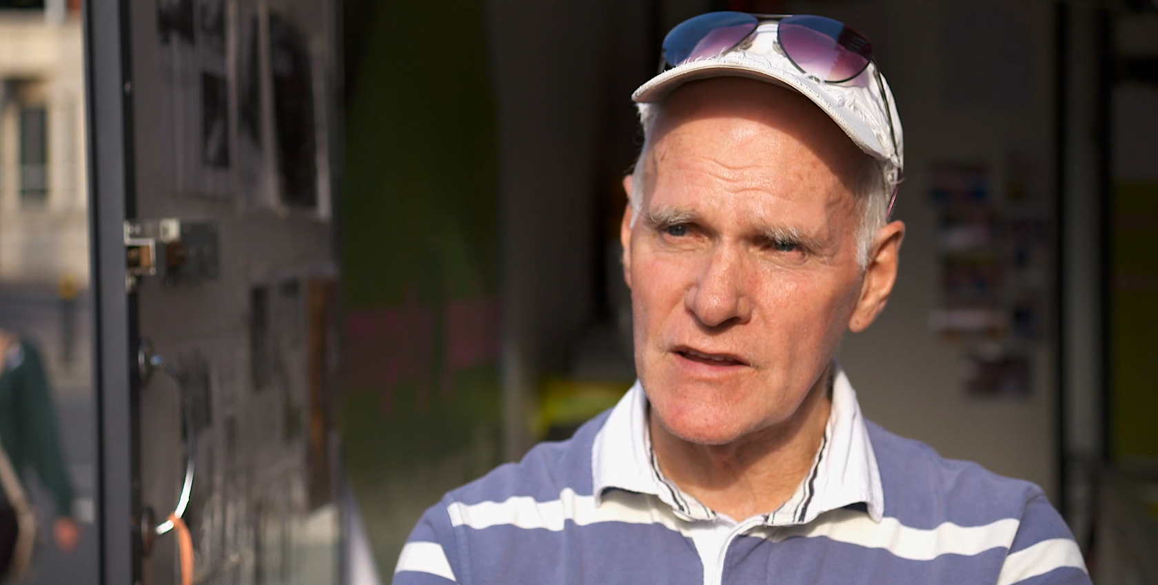
I can't signify the naming as such. You'd have to explain that as to the differential on both of the questions you've asked.
Notes:
This is Jimmy. He’s not a scientist. He runs a juice bar round the corner from our office.
We went round with a camera crew a couple of years ago asking people about pensions – a surefire way to suck the joy out of someone’s lunch hour.
When we talked to Jimmy, we asked him if he could tell us what an annuity was.
He said: I can’t signify the naming as such. You’d have to explain that as to the differential on both of the questions you’ve asked.
I’m pretty sure he never normally talks like this. But when we started talking to him in pensions speak, he started to try to talk it back to us. In fact, we found most people we talked to fell into a kind of garbled financial speak.
So how we talk to people affects the way they talk back to us. When we’re asking them to make a tough decision or fill in a form, we don’t want them in this mindset.
Is it in any wonder we’re turning people’s brains into cheesecake when you read definitions like this?

Slide 32
Talk like a real person
Assume intelligence, not knowledge
Choose words that resonate
Notes:
Firstly, the people you’re talking to aren’t experts.

Slide 33
Seaside
Notes:
Repeat each word as people call them out, to make sure everyone has heard them, and to encourage people to join in. People normally say words like sand, sun, deckchairs, donkey, holiday, fun.
Then ask them to call out words for the next slide.

Slide 34
Coastal region
Notes:
Again, repeat each word as people call them out. People normally say things like cliffs, geography field trip, school, rain.

Slide 35

Notes:
When you think about it, ‘seaside’ and ‘coastal region’ mean the same thing – it’s where the wet bit meets the dry bit.
But the words ‘seaside’ and ‘coastal region’ make us think of very different things. They make us feel very different
Explain that ‘resonant words’ are ones that, because of our life experience, mean something positive to us. They play on positive associations and memories. We tend to use them in conversation, but businesses often choose less resonant words – ‘assistance’ instead of ‘help’. But no one who was in trouble would ever call out ‘Assistance! Assistance!’. ‘Children in need’ not ‘minors who require some assistance’. So we should choose resonant words to build relationships with our customers.

Slide 36
Sally will also have a guaranteed index linked income for the rest of her life should you predecease her.
Notes:
RESONANT WORDS EXAMPLE

Slide 37
Sally will also have a guaranteed index linked income for the rest of her life should you predecease her.
Sally will also have a guaranteed index linked income for the rest of her life should you die before her.
Notes:
RESONANT WORDS EXAMPLE

Slide 38
If however you no longer wish to receive my review service you are at liberty to cancel this charge at any time and can do so by contacting the provider directly and confirming your wish for this payment to cease.
But, if you no longer want my review service, you can cancel at any time. You can do this by getting in touch with the provider, and letting them know you want to stop your payment.
Notes:
RESONANT WORDS EXAMPLE

Slide 39
Wait – but isn’t this dumbing down?

Slide 40
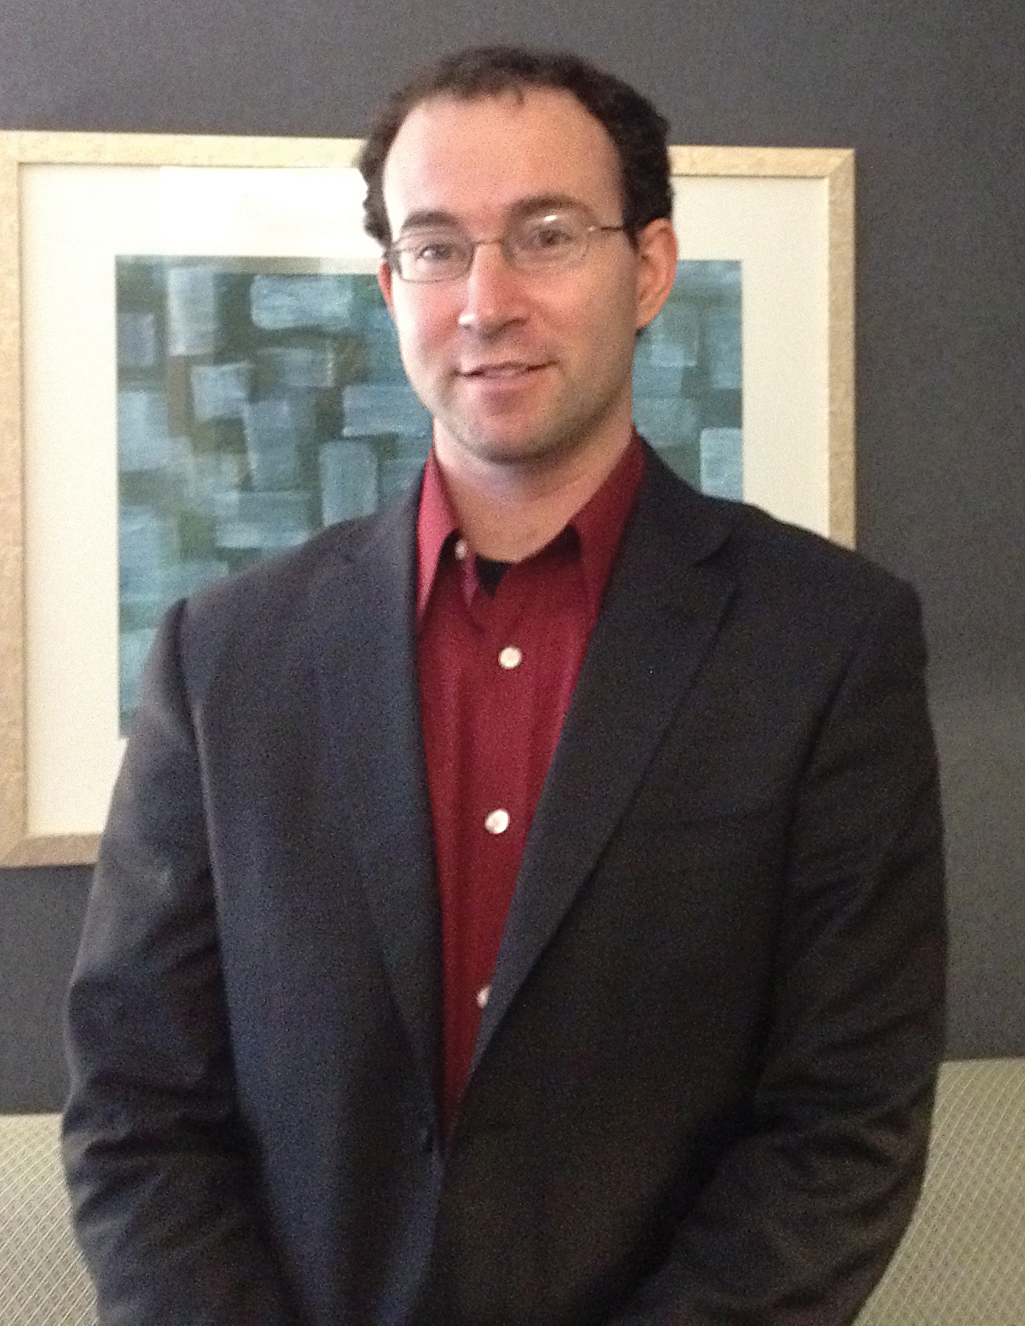
Meet Professor Daniel Oppenheimer
Notes:
He’s Danny Oppenheimer, professor of Psychology at UCLA. He won something called the Ignobel Prize – a pun on Nobel and Ignoble – remember that if you have to explain your puns, they’re probably not good enough. Anyway, the prize is awarded for research that makes you laugh then makes you think. Danny won it for a research study called…

Slide 41
Consequences of Erudite Vernacular Utilized Irrespective of Necessity
Notes:
Consequences of Erudite Vernacular Utilized Irrespective Of Necessity, or

Slide 42
Consequences of Erudite Vernacular Utilized Irrespective of Necessity
Problems with using long words needlessly
Notes:
Problems with using long words needlessly.
Daniel Oppenheimer invented an algorithm that would trawl through people’s applications to university, or their essays, and play around with the words they used – creating whole essays full of highly complex words, moderately complex words and short, not very complex at all words. The applications and the essays had the same content and structure. All that changed was the vocabulary.

Slide 43
Using long words needlessly
Long words
Short words
Lowest
Highest
Notes:
People rated the shorter words highest and the highly complex words lowest. And they thought the essay with shorter words was more fluent.
“Contrary to prevailing wisdom, increasing the complexity of a text does not cause an essay’s author to seem more intelligent. In fact, the opposite appears to be true…Complexity neither disguised the shortcomings of poor essays, nor enhanced the appeal of high-quality essays. The mediation analysis suggests that the reason that simple texts are viewed more positively than complex texts was due to fluency. Complex texts are difficult to read, which in turn…lowers judgements of an author’s intelligence.”
So if we are trying to sound clever either consciously or subconsciously, it’s having the opposite effect to the one we want.
And here’s the kicker – the applications with short words in were more likely to be accepted. The essays with shorter words got higher marks. If we want to get the best results, we have to listen.
There’s another great reason of course – and that’s that our audiences might prefer it too. It seems intuitively obvious that an unsophisticated audience will prefer a simpler message – because of clarity, comprehension, even reading age – but our last scientist found out that sophisticated audiences prefer simple language too.

Slide 44
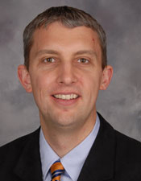
Meet Professor Christopher R. Trudeau
Notes:
His name’s Christopher Trudeau. He’s a professor at the Thomas M Cooley Law School at Michigan State University.

Slide 45
There was a statistically significant correlation between educational level and the likelihood that a respondent would choose the plain-language version. That is, as education increased, so did the preference for plain language.
Notes:
We also sometimes get told that that a conversational style means ‘dumbing down’. Or that a particular audience is highly educated and therefore want complex language. In fact, Trudeau’s research shows the opposite is true.
Traditional legal language is about as complex and formal as you get. Trudeau looked at whether clients, potential clients and the public preferred the traditional approach or plain language. Perhaps not surprisingly, they overwhelmingly preferred plain language.
But Trudeau was more surprised by his findings on the link between respondents’ level of education and their preference for plain language. He’d assumed that the lower the respondent’s education, the more likely they were to prefer the plain language version. But the opposite proved to be true.
He’s made it his life’s work to stamp out legalese. He now teaches legal drafting.

Slide 46
There was a statistically significant correlation between educational level and the likelihood that a respondent would choose the plain-language version. That is, as education increased, so did the preference for plain language.
These results debunk the argument that higher-educated people will not mind traditional legal language as much as others do. Rather, even though people with advanced degrees might understand traditional legal style, that’s not what they prefer.
Notes:
QUOTES
Clear, simple language is not dumbing down. Educated people know what’s clear and they appreciate it.
Last, a quick history lesson…

Slide 47
Talk like a real person
Assume intelligence, not knowledge
Choose words that resonate
Use strong verbs not abstract nouns
Notes:
Using verbs instead of abstract nouns help us to ’put people in’ to our writing.
Nouns are things. Table, lorry, dog, umbrella are all examples of nouns. They are things you could touch, if you wanted to.
Abstract nouns are things you can’t touch. They often represent big ideas. Like these…

Slide 48
Design
Democracy
Peace
Heroism
Imagination
Love
Health
Notes:
So these are abstract nouns. They’re not always bad. They can describe big, lofty, great ideas like love, heroism, imagination.
But, big organisations use certain kinds of abstract nouns all the time, like these…

Slide 49
Management
Facilitation
Strategy
Engagement
Documentation
Communication
Collaboration
Notes:
You’ll notice a lot of these end in –tion or –ment.

Slide 50
Identification
Recuperation
Confirmation
Requirement
Expiration
Reduction
Recommendation
Notes:
These are the kinds of abstract nouns that crop up in your writing examples.

Slide 51
Preparation for retirement
Preparing for retirement
Preparing to retire
Getting ready to stop work
Notes:
Here are two abstract nouns. They end in –tion and –ment. A lot of abstract nouns that have this kind of ending are based on verbs. That makes them quite easy to spot.
For example, ‘preparation’ is based on the verb ‘to prepare. We can turn it back in to a verb like this. Suddenly, we’re suggesting that there is someone involved – someone is ‘preparing’ But they’re preparing for a ‘thing’, not preparing to DO something.
So we can do the same for ‘retirement’ – turn it back into the verb it’s built on. Now someone is preparing to DO SOMETHING – retire.
Once we have turned our abstract nouns back in to verbs, we can choose different verbs if we want to. Perhaps something more resonant.

Slide 52
If you require any further clarification, please contact me immediately.
If you need me to clarify anything, please get in touch.
If you need me to clear anything up, please get in touch.
Notes:
Bonus – forces you to put a person in. Hold that thought…

Slide 53
Talk like a real person
Assume intelligence, not knowledge
Choose words that resonate
Use strong verbs not abstract nouns
Put people in

Slide 54
The following original documents are required.
We require the following original documents from you.
We’ll need you to send us the following original documents.
Notes:
Putting people in is a simple way to give your writing more energy, and make your message easier to understand.
Passive sentences – those that put the object first – are more difficult to understand. It takes you longer to process the message.
How can we put people into the sentence on the left, and make it active?
First of all, let the reader know who requires the documents.
Then, make it clearer that you need the reader to send those.

Slide 55
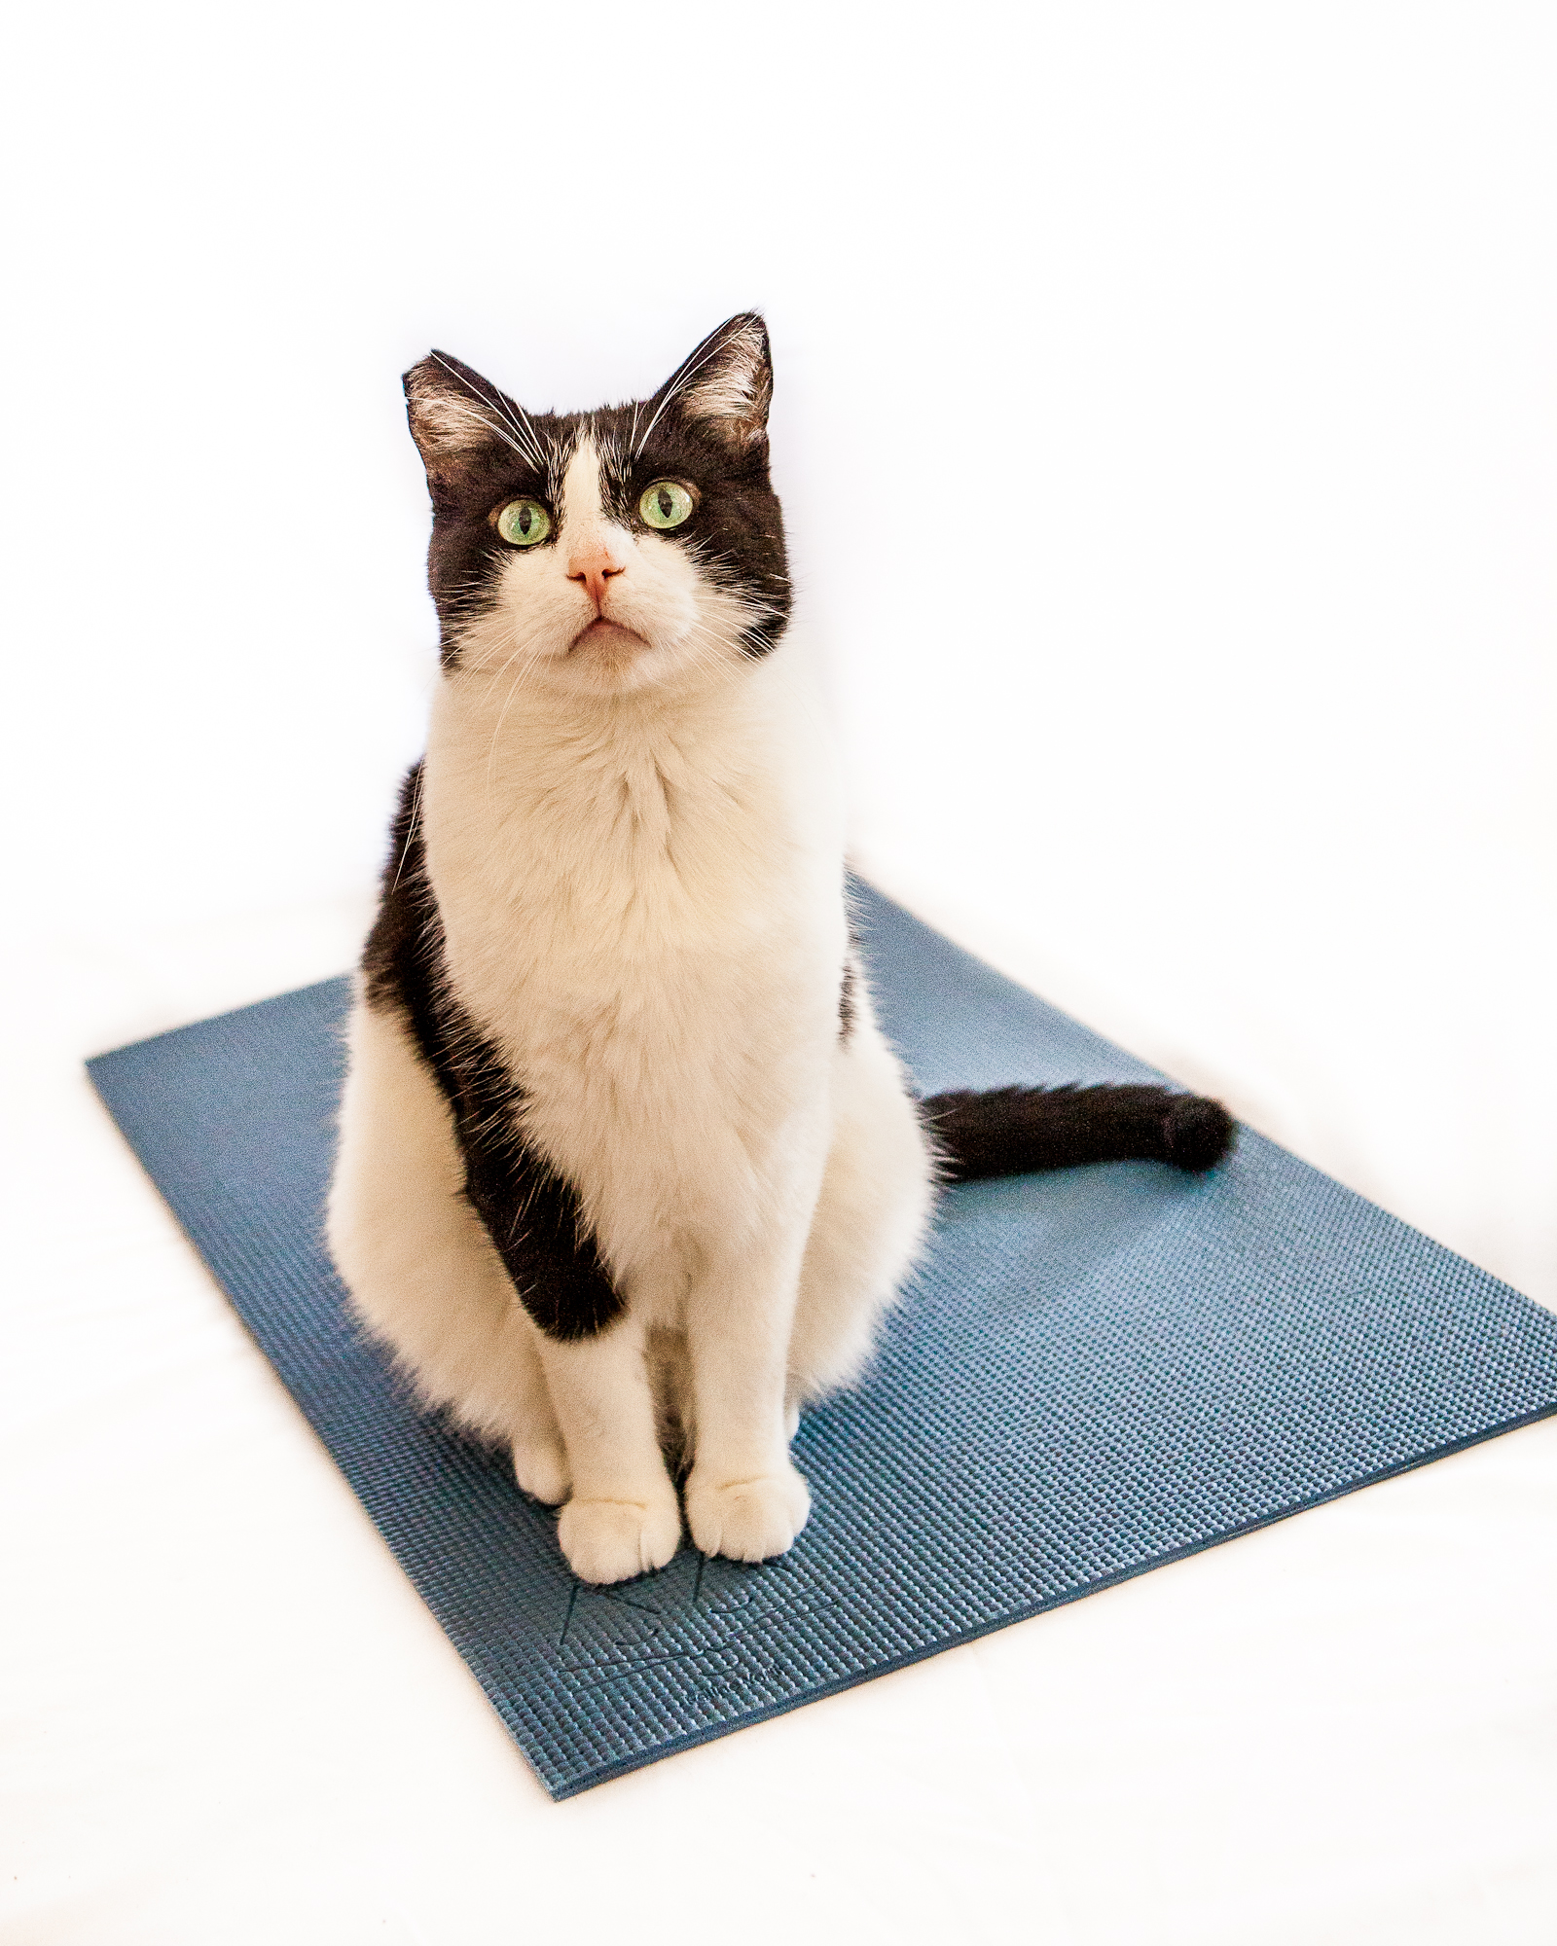
Using the active voice
The cat sat on the mat.
Notes:
This sentence uses the active voice.

Slide 56
Using the active voice
The cat
WHO
Notes:
The cat is the subject – the person (animal) that is doing something.
It comes first

Slide 57
Using the active voice
The cat
sat on
WHO
DID SOMETHING
Notes:
Then comes the thing it is doing – sitting.
The verb (the ‘doing word’) is ‘to sit’

Slide 58
Using the active voice
The cat
sat on
the mat
WHO
DID SOMETHING
TO WHAT
Notes:
The object comes last. The mat is the thing that’s having something done to it.
It’s being sat on.
In the active voice, we’re focusing on the person doing something.
The cat is our focus.

Slide 59
Using the active voice
The mat was sat on by the cat.
Notes:
This is the passive voice.
It puts the object first and the subject later.
So here we start with the thing that is having something done to it.

Slide 60
Using the passive voice
The mat
was sat on
by the cat
WHAT
HAD SOMETHING DONE TO IT
BY WHOM
Notes:
Instead of subject – verb – object, we have object – verb – subject.
The meaning is the same either way round.
So what’s the difference?

Slide 61
Using the passive voice
The mat
was sat on
by the cat
WHAT
HAD SOMETHING DONE TO IT
BY WHOM
Notes:
The first difference between active and passive, is that with passive, this can happen.
We can lose the subject.

Slide 62
Using the passive voice
The mat was sat on.
Notes:
This still makes sense, but we don’t know who is doing the sitting.

Slide 63

Notes:
Here’s another reason it’s good to use the active voice.
- Describe how you might hear a crash and a child comes in. They say ‘I broke the goldfish bowl’. Then describe the same scene but the child says ‘The goldfish bowl got broken’.
Ask which is active and which passive.
Why did the second child use passive? To avoid blame.
Since childhood we’ve associated the passive voice with avoiding blame. We still use it for that, and when we hear it we think others are doing the same.
It’s common to hear it from large organisations, civil servants, politicians – anyone who doesn’t want to take responsibility.
So if we use the active voice, we’ll be taking responsibility for our actions.

Slide 64
Meet Professor Richard Wiseman
Notes:
Meet Professor Richard Wiseman. He’s a psychologist, and Professor of the Public Understanding of Pyschology at the University of Hertfordshire. He often conducts mass public experiments involving tens or even hundreds of thousands of participants. He’s done lots of research into lying, including the verbal and non-verbal indicators that can help you spot a liar. He found that vocal and verbal cues are more accurate indicators of when a person is lying than visual cues.

Slide 65
The language of liars
Liars remove themselves from the story by avoiding pronouns like I, mine and myself
Liars use longer and more convoluted sentence structure by padding things out with unnecessary, complicated words
Notes:
Research shows that when people lie, they tend to do these things with their language. They avoid pronouns like I, mine and myself to distance themselves from the story. If we extend this to how it’d apply to businesses, that means avoiding pronouns like ‘we’ and ‘us’, and ‘our’, too – just like the robot did. We want to do the opposite – build relationships – so we want to put both ourselves and our reader into the story.
And they use longer and more convoluted sentence structure, padding things out with unnecessary, complicated words and rambling sentences, just like a the robot did.
The way businesses talk often uses these techniques too, because they think it sounds more professional or senior. But research shows that if you talk in this way – you might sound like you’re trying to hide something.

Slide 66
Whilst every effort has been made to ensure accuracy, no liability can be accepted for any errors or omissions.
Whilst we’ve made every effort to ensure accuracy, we can’t accept liability for any errors or omissions.
We’ve done as much as we can to make sure the information is accurate. If we’ve made any mistakes or left anything out, we’re not liable.
We’ve done as much as we can to make sure the information is accurate. If you notice a mistake, please let us know. Otherwise, we’re not liable for any mistakes you notice later down the line.

Slide 67
2. Cut to the chase
Use short sentences

Slide 68
This would be the most tax-efficient way of drawing this income and it would also be the most sensible way as you would not be drawing down on crystallised funds that are deemed income producing therefore you would not affect your annual allowance and would be able to make pension contributions in the future up to the maximum annual allowance of £40,000 as opposed to triggering the Money Purchase annual allowance restriction of £10,000.
This would be the most tax-efficient way of drawing this income. It would also be the most sensible way. That’s because you would not be drawing down on crystallised funds that are deemed income producing, so you would not affect your annual allowance. This means you would be able to make pension contributions in the future up to the maximum annual allowance of £40,000, as opposed to triggering the Money Purchase annual allowance restriction of £10,000.

Slide 69
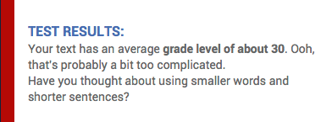
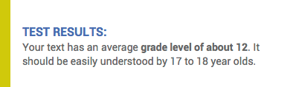
This would be the most tax-efficient way of drawing this income and it would also be the most sensible way as you would not be drawing down on crystallised funds that are deemed income producing therefore you would not affect your annual allowance and would be able to make pension contributions in the future up to the maximum annual allowance of £40,000 as opposed to triggering the Money Purchase annual allowance restriction of £10,000.
This would be the most tax-efficient way of drawing this income. It would also be the most sensible way. That’s because you would not be drawing down on crystallised funds that are deemed income producing, so you would not affect your annual allowance. This means you would be able to make pension contributions in the future up to the maximum annual allowance of £40,000, as opposed to triggering the Money Purchase annual allowance restriction of £10,000.

Slide 70
2. Cut to the chase
Use short sentences
Put the important stuff up front

Slide 71
2. Cut to the chase
Use short sentences
Put the important stuff up front
Cut anything you don’t need

Slide 72
I have undertaken an analysis of your needs and requirements.

Slide 73
I have undertaken an analysis of your needs and requirements.
I have analysed your needs.

Slide 74
3. Guide your reader
Use headings that mean something
Notes:
Firstly, the people you’re talking to aren’t experts.
See it from their point of view. What do they need to know?
If they skimmed and only read the headings, would they learn anything?

Slide 75
3. Guide your reader
Use headings that mean something
Use bullets consistently
Notes:
Firstly, the people you’re talking to aren’t experts.

Slide 76
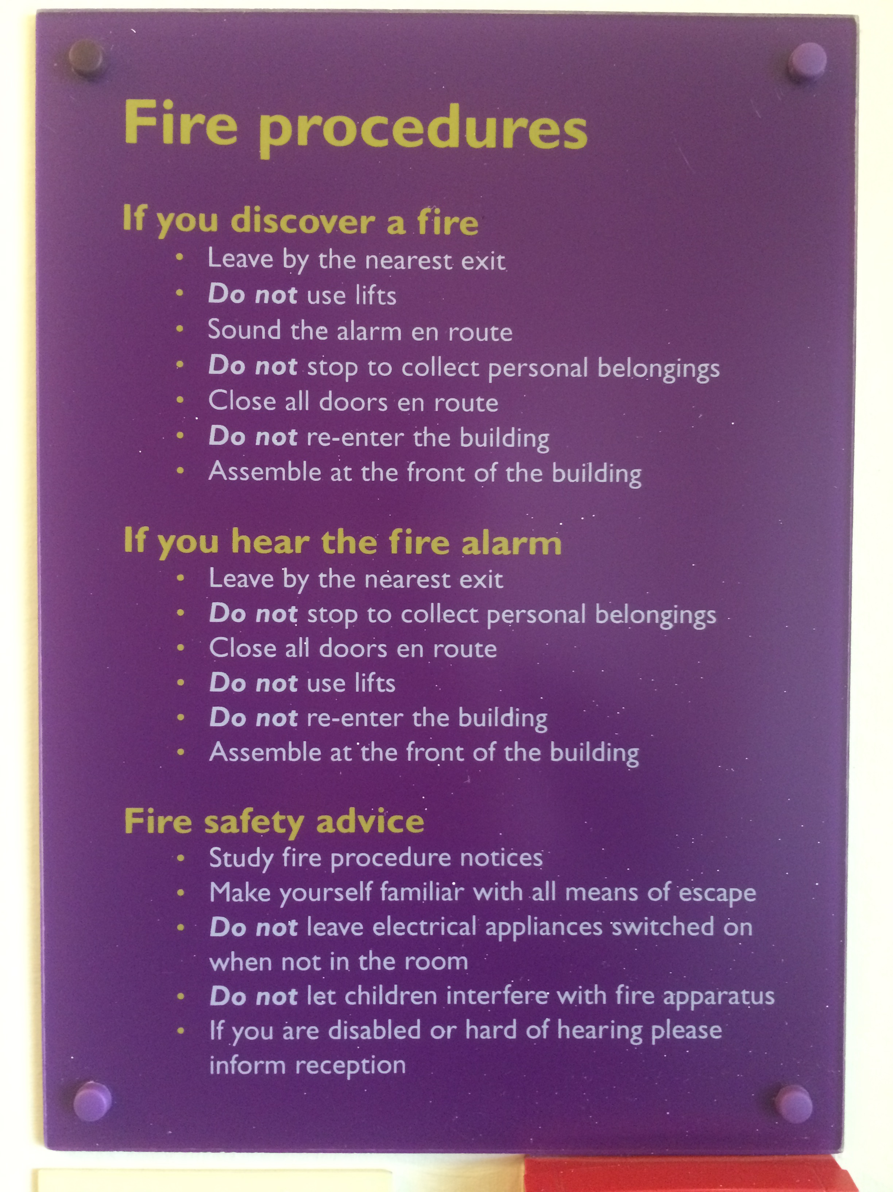
Use bullet points carefully

Slide 77
3. Guide your reader
Use headings that mean something
Use bullets consistently
Break your contents into sections

Slide 78
Let’s put it all together

Slide 79
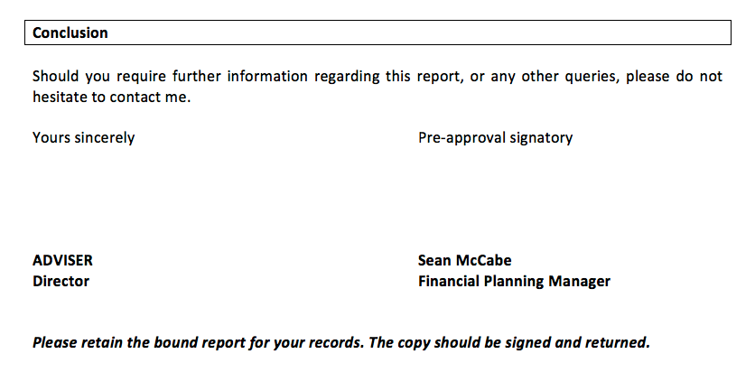

Slide 80
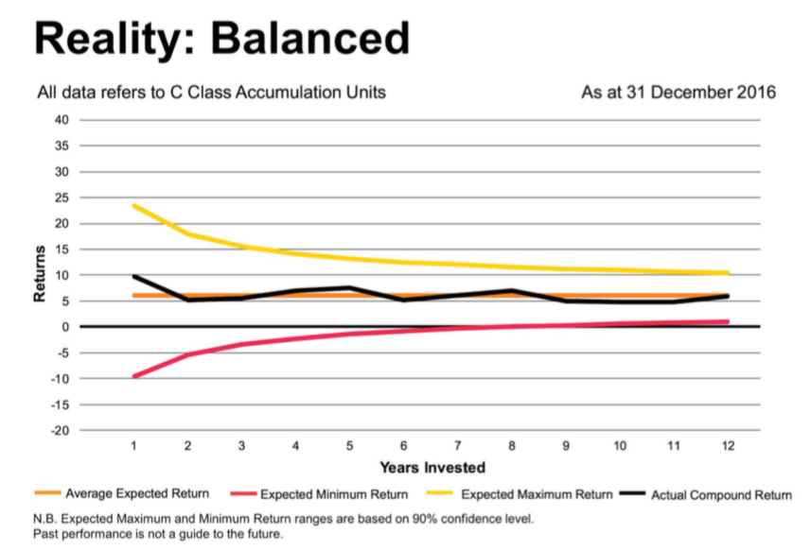

Slide 81
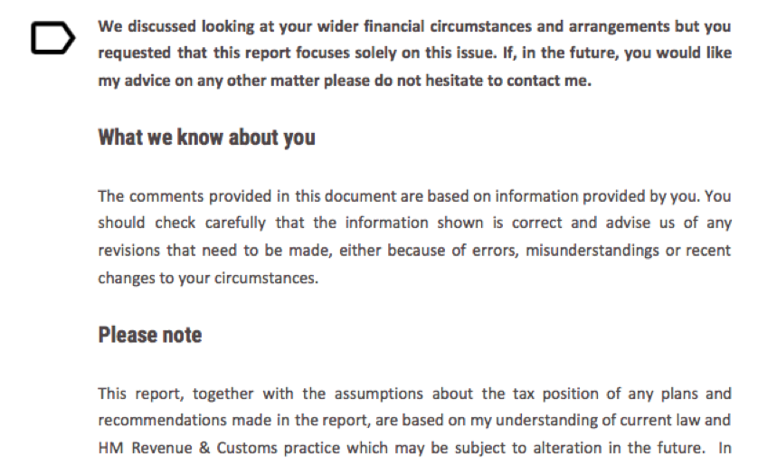

Slide 82
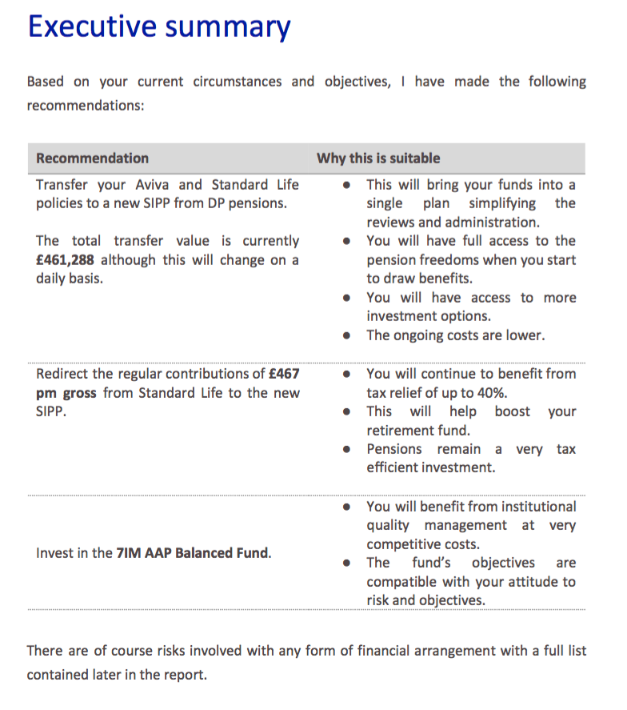
A summary of what we recommend
What we recommend and why it’s suitable for you
Notes:
Tricky heading – they’ve all grappled with this and have different solutions.
A summary of what we recommend?
What we recommend and why it’s suitable for you?
Look at the nice layout. Dead clear.

Slide 83
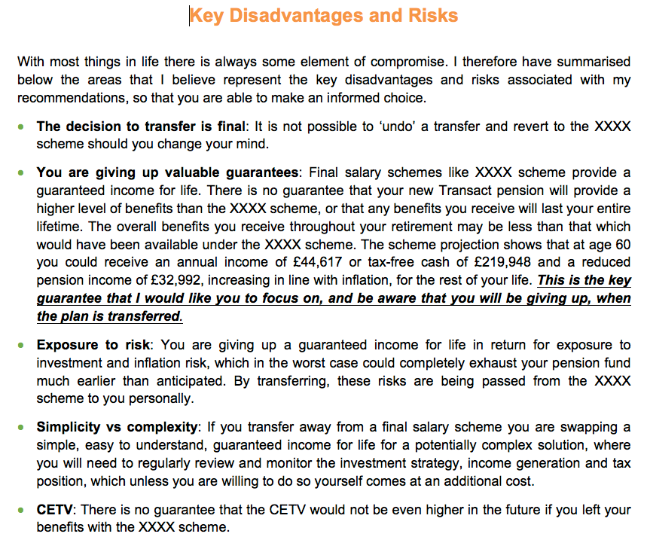

Slide 84
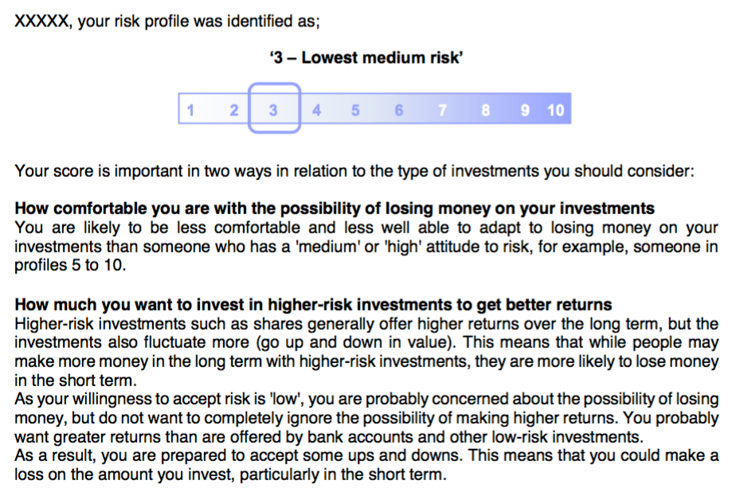

Slide 85
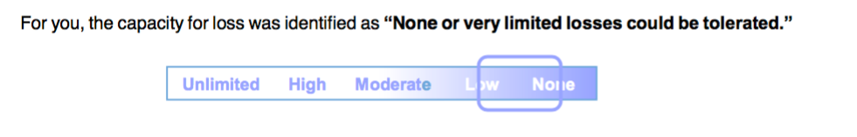

Slide 86
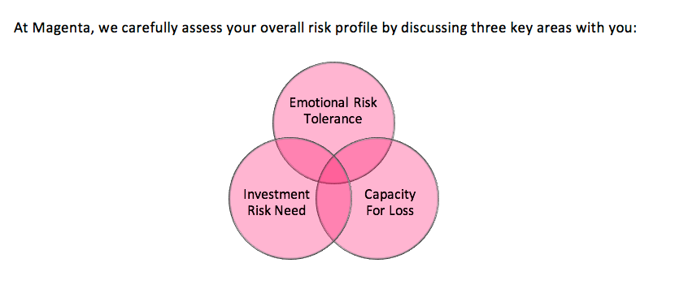

Slide 87
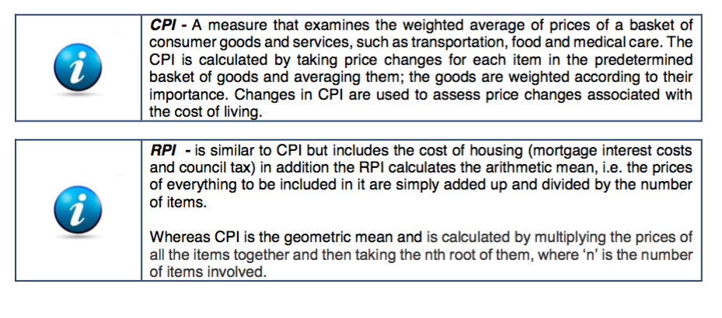

Slide 88
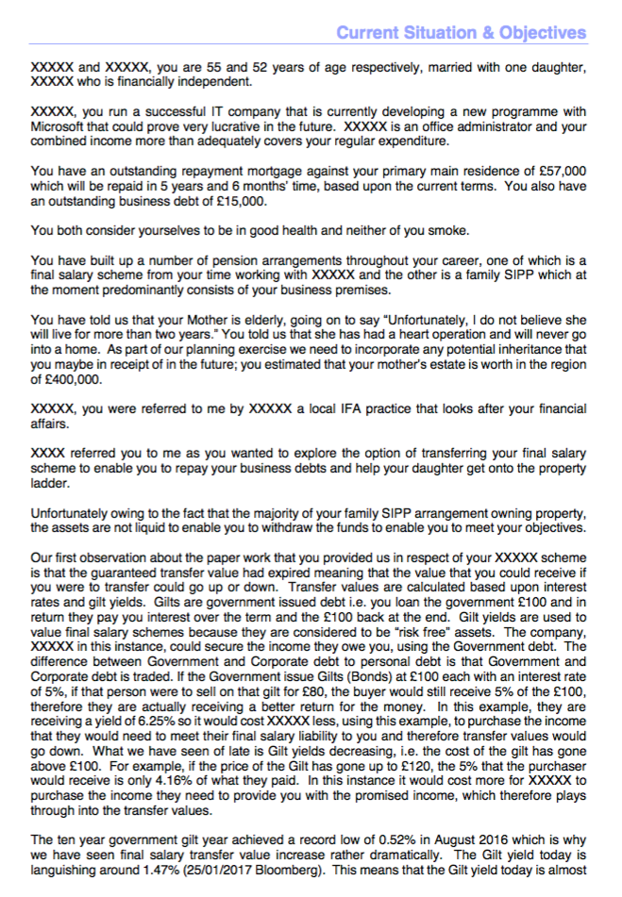


Slide 89
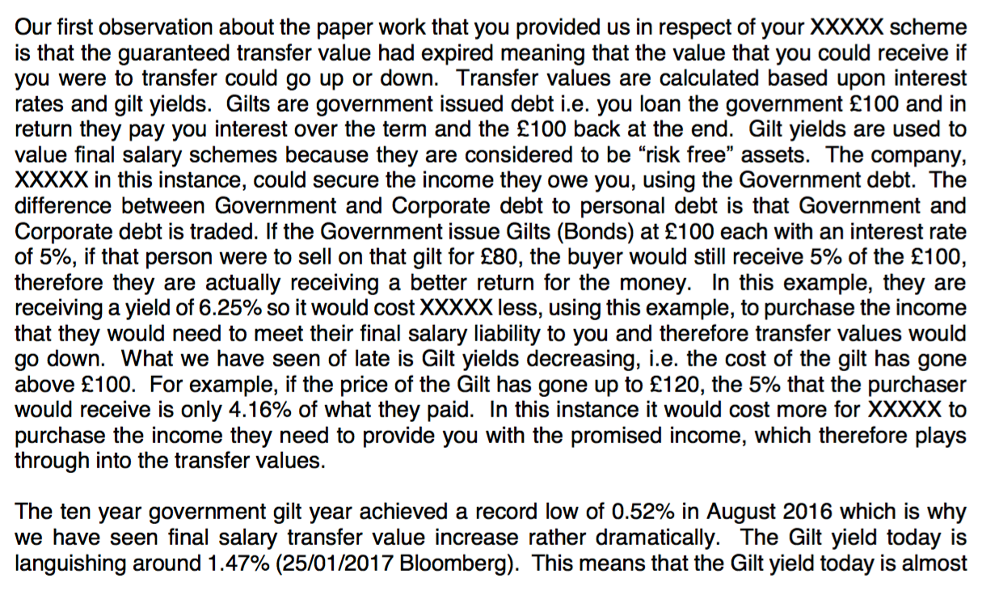

Slide 90
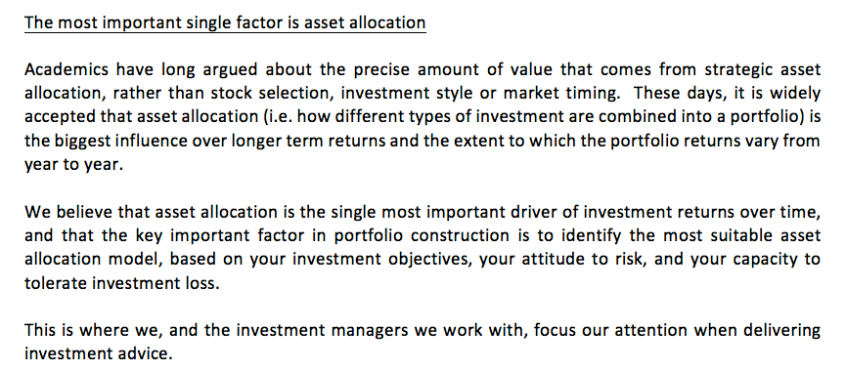
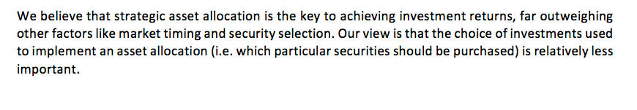
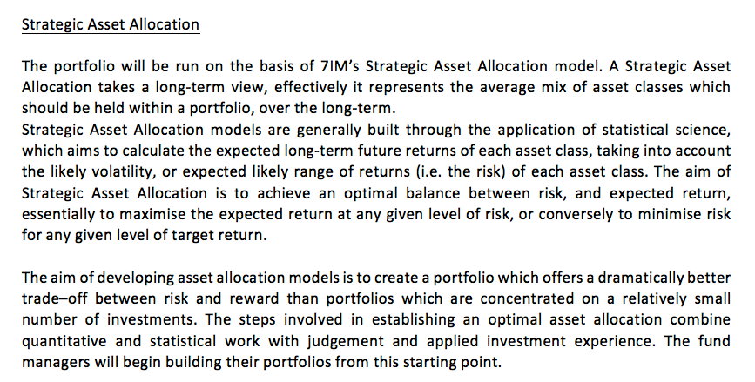
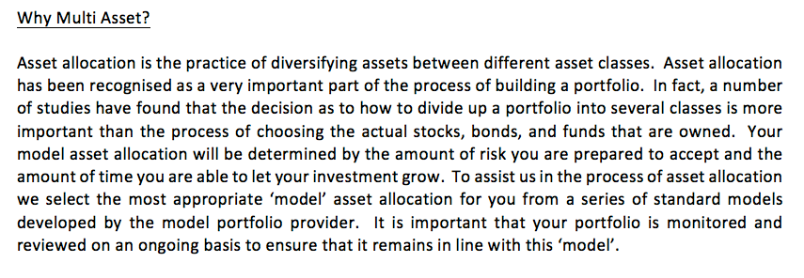
page 22
page 27
page 26
page 28

Slide 91
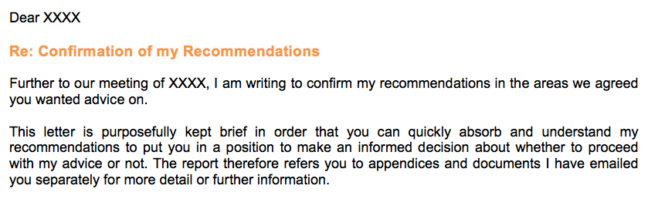
Notes:
Throat-clearing

Slide 92
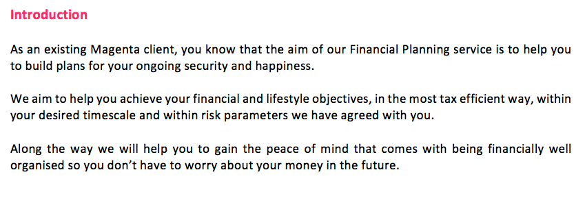
Notes:
Throat-clearing.
But lovely last line. That’s what it’s all about.
Leading into: good examples of colloquial language.

Slide 93
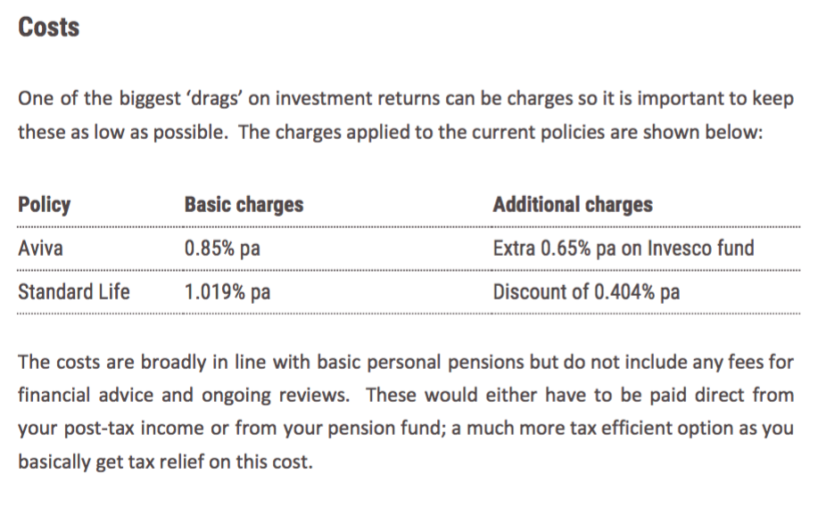

Slide 94
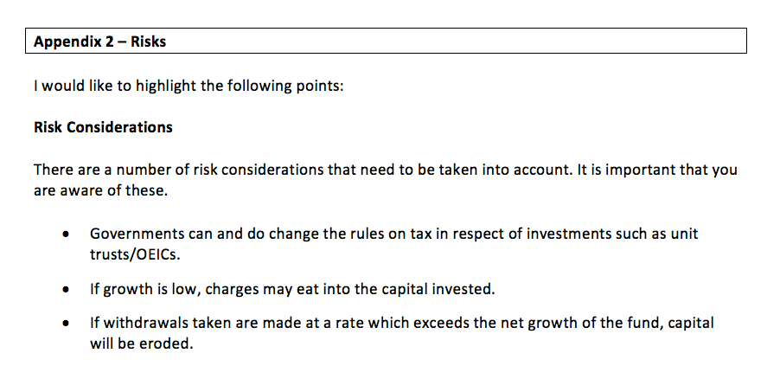
Notes:
This is p.18 of the report
OEIC is explained on page 31 – ‘What is an Open-Ended Investment Account & Unit Trust Portfolio?’

Slide 95
Risks to your investments
The government might change the rules about how they tax investments.
If your investments don’t grow by more than the amount we charge in fees, the fees will eat into your capital.
If you take out more money than the amount your investments grow, what you take out will eat into your capital.

Slide 96
Here’s what we talked about today
Talk like a human
Assume intelligence, not knowledge
Use words that resonate
Use strong verbs instead of abstract nouns
Put people in

Slide 97
Here’s what we talked about today
Talk like a human
Cut to the chase
Use short sentences
Put the important stuff first
Cut

Slide 98
Here’s what we talked about today
Talk like a human
Cut to the chase
Guide your reader
Use headings that mean something
Use bullets consistently
Break your contents into sections

Slide 100
Thanks

Slide 101
BREAK

Slide 102
The words
Joe craig
quietroom
the tech
David pike
brochet
the rules
Mark goold
the fca

Slide 103
david
pike

Slide 104
The words
Joe craig
quietroom
the tech
David pike
brochet
the rules
Mark goold
the fca

Slide 105
mark
goold

Slide 106
Suitability reports
Personalise and Engage
27 July 2017

Slide 107
Learning objectives
Understand the FCA’s expectations on suitability reports
Consider ways of improving client engagement with documentation
Identify if any further action is required to improve the existing process when building reports

Slide 108
The story of advice
Beginning - Understanding the Need
Middle - Establish the Solution
End - Presenting the Solution

Slide 109
Suitability reports - What do we see?
Many reports not personalised
Report did not state disadvantages of recommendation
Did not clearly set out the review process
The cost of advice
Irrelevances

Slide 110
Suitability reports - What do we see?
Client Agreement
Alternative Products
Product Charges
Taxation of investments (internal, impact on client’s tax position and what needs to be reported to HMRC)

Slide 111
Suitability reports - COBS 9.4
Demands and needs (i.e. the client objectives)
Why suitable for the client
Possible disadvantages (i.e. the risks)
(additional guidance for some more complex areas such as income withdrawals, pension transfers)

Slide 112
Suitability reports
evidence of client needs and objectives
why do you believe the advice is suitable/ client benefit / disadvantages
confirmation of client attitude to risk and reconfirmation of risk descriptions
replacement business comparison of existing arrangements with new arrangement
reference to documents (eg KIIDs and KFDs)
any loss of benefits/exit penalties to the client
if your recommendation is more expensive, why?
why provider recommended
importance and confirmation of review process/ cost of advice
Not exhaustive and to be relevant to the client

Slide 113
Suitability Report design tips
Linking related information
Font size
Tables and diagrams to explain complicated information
Use of bold text, colour and highlighting
Use the words of the client

Slide 114
Assessing suitability: what we found
Reviewed 1142 recommendations
656 firms
3 Advice Types (Investment, Pension Accumulation & Retirement Income)
 | Overall | Suitability Report
Suitable | 93.1% | 92.8%
Unsuitable | 4.3% | 5.6%
Unclear | 2.6% | 1.6%

Slide 115
Summary
Be aware of the requirements
Personalise the document
Engage the client with the content
This will lead to :
Informed Position

Slide 116
Any Questions ?

Slide 117
CHow!

Slide 118
paraplanner panel
what we do
vs
what we could do

Slide 119
campfire 1
the words
campfire 2
the tech
campfire 3
the rules

Slide 120
What’s next?
the National paraplanners powwow
14 september 2017
held in rolling countryside,
under open skies, in teepees

Slide 121


